Slide 1
Project Slideshow
Write a comment for each picture.
How does the picture make you feel?
What would you tell a friend about that picture?

Slide 2
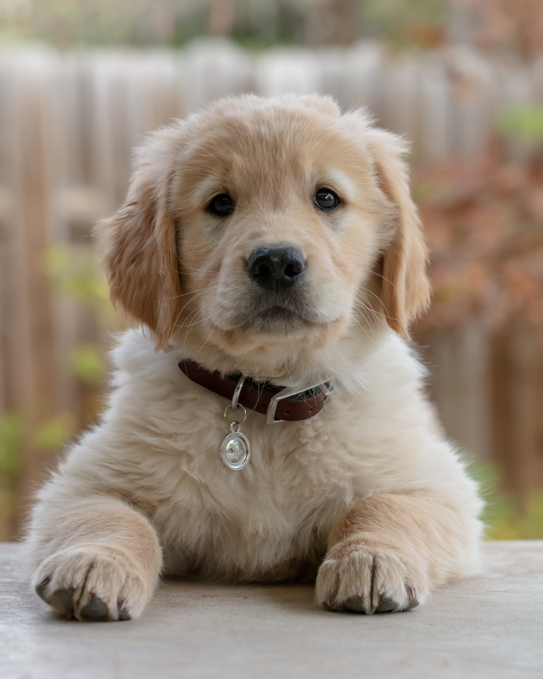

Slide 3
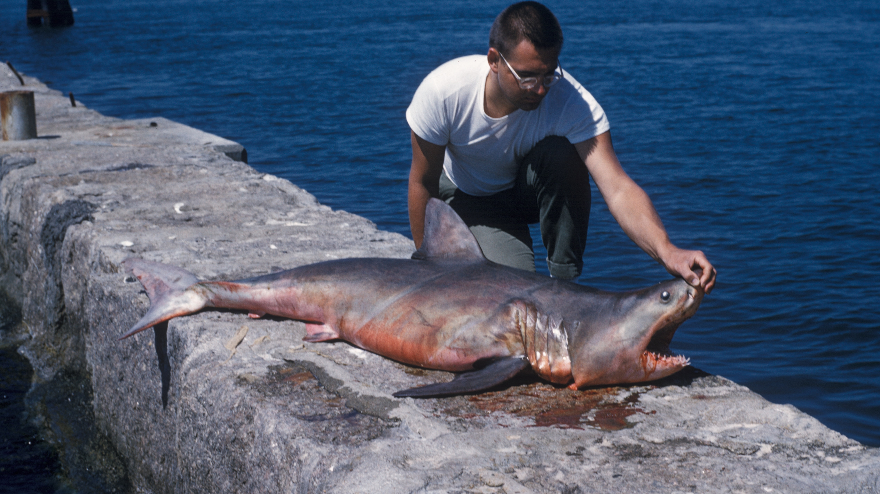

Slide 4
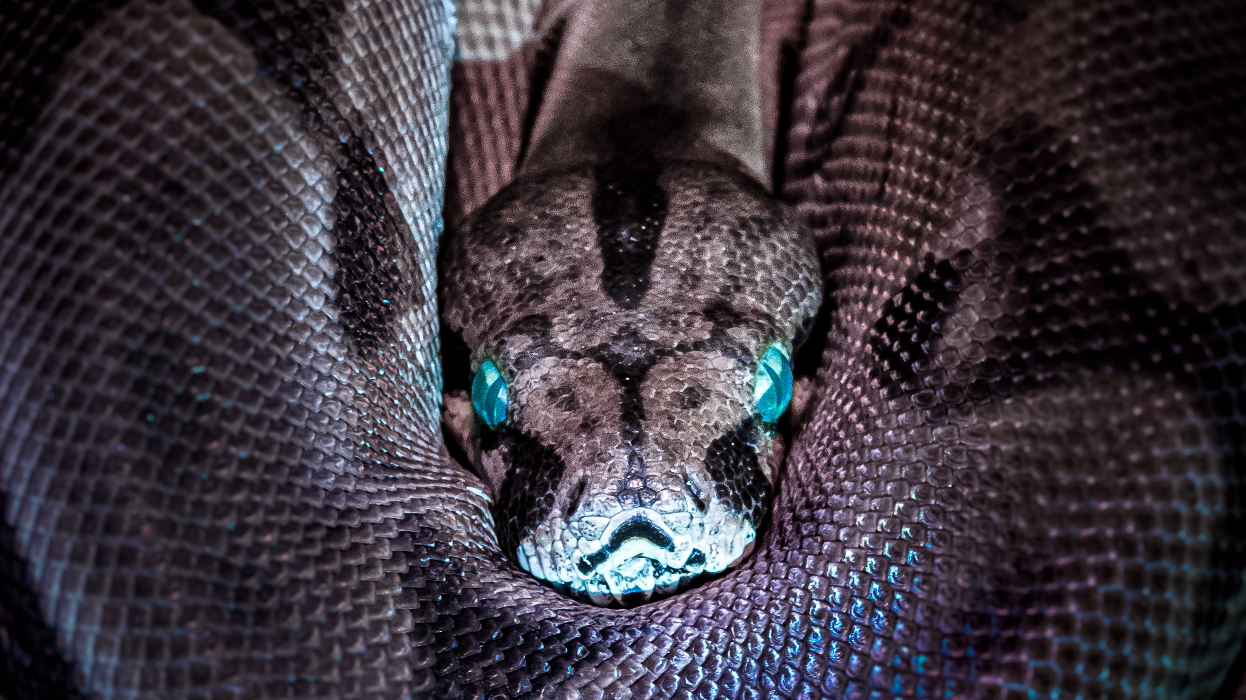

Slide 5
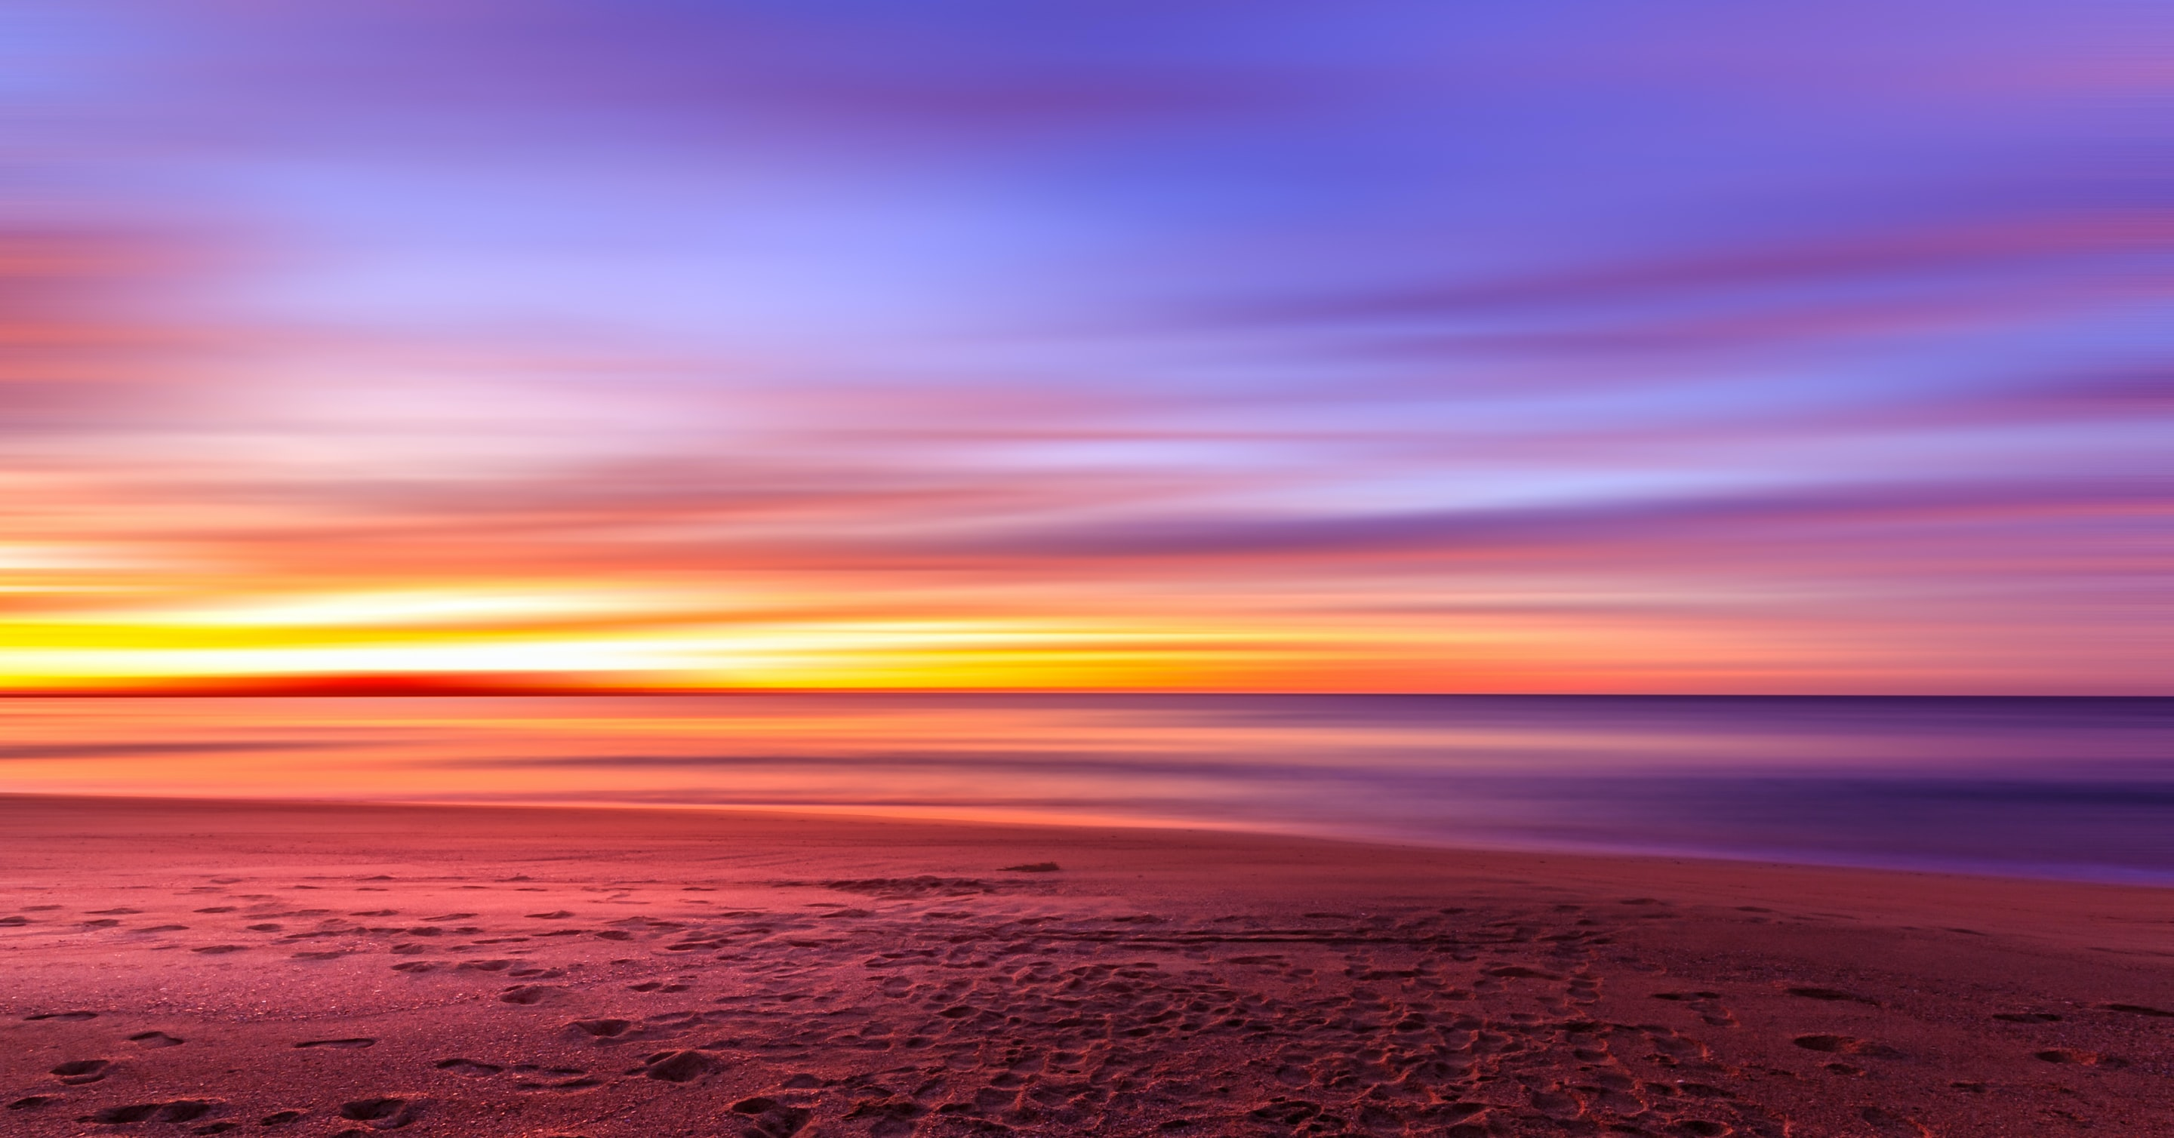

Slide 7
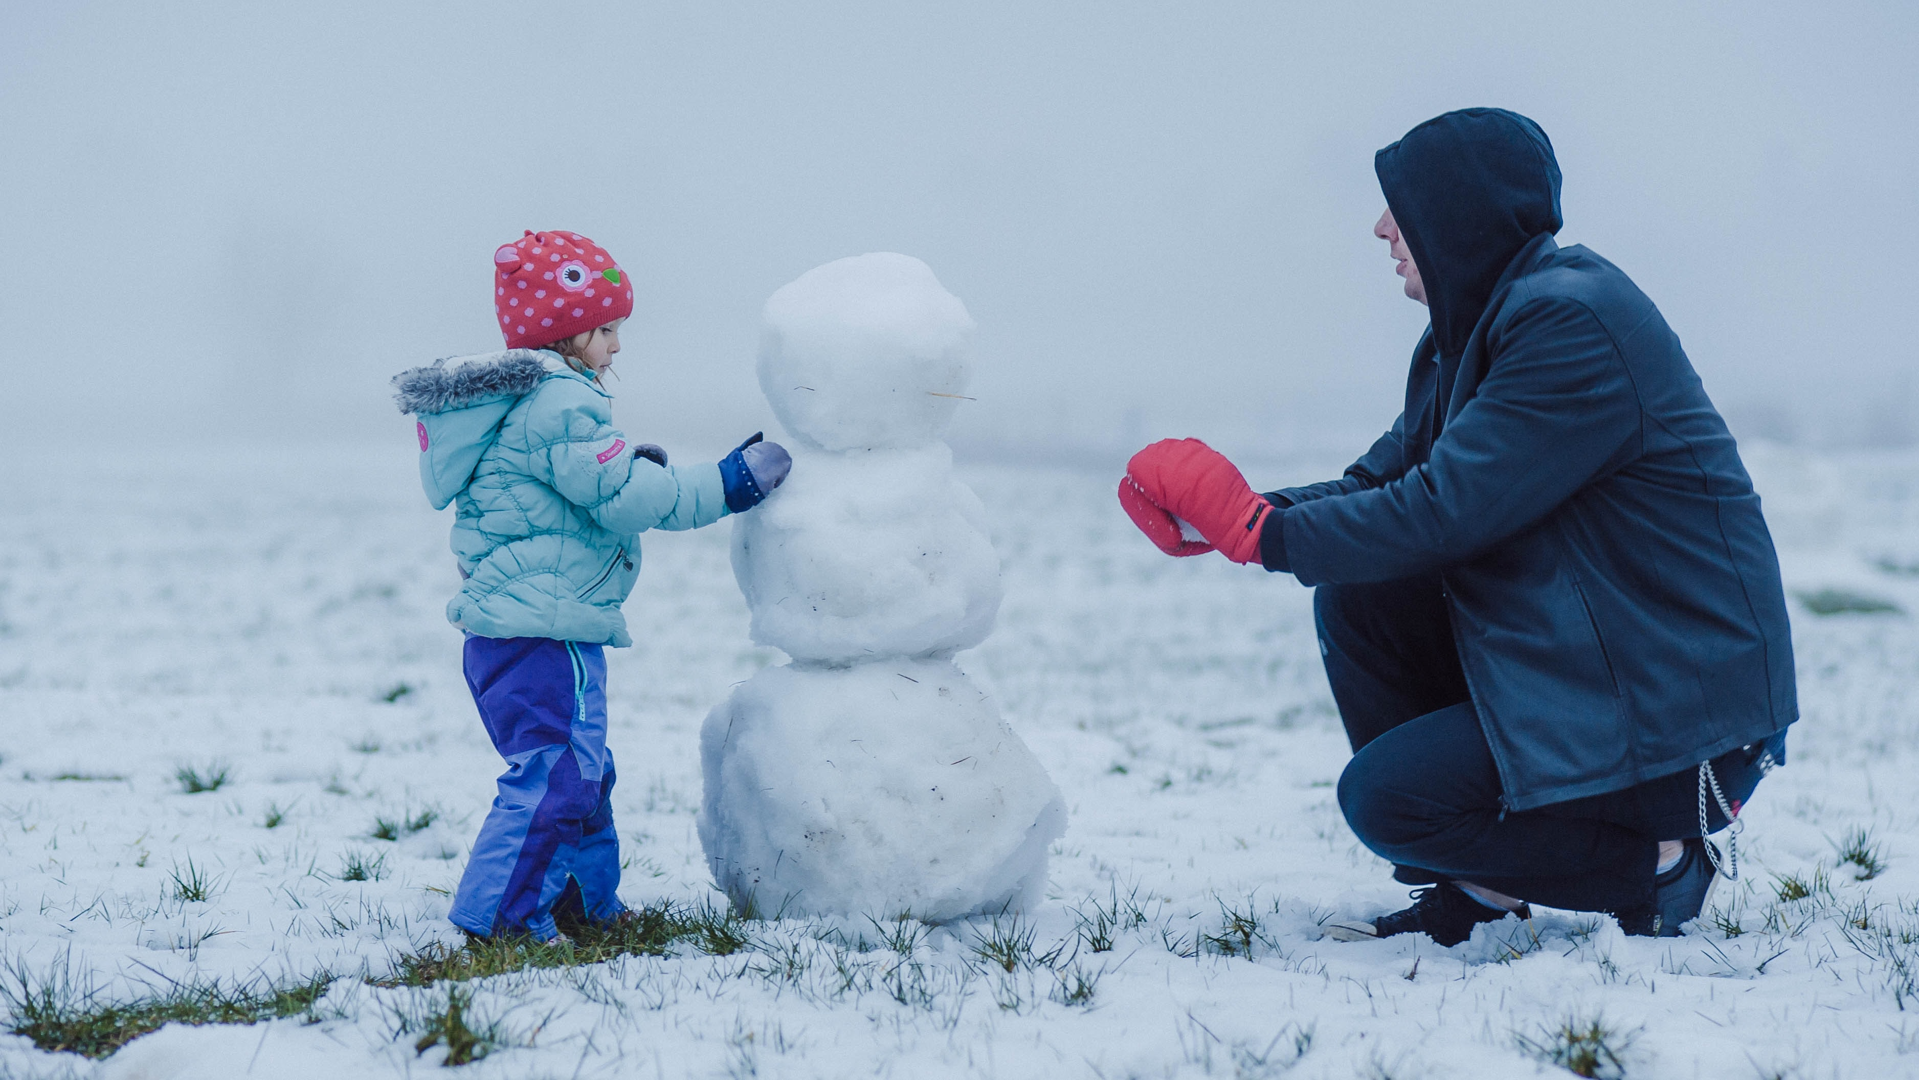

Slide 8
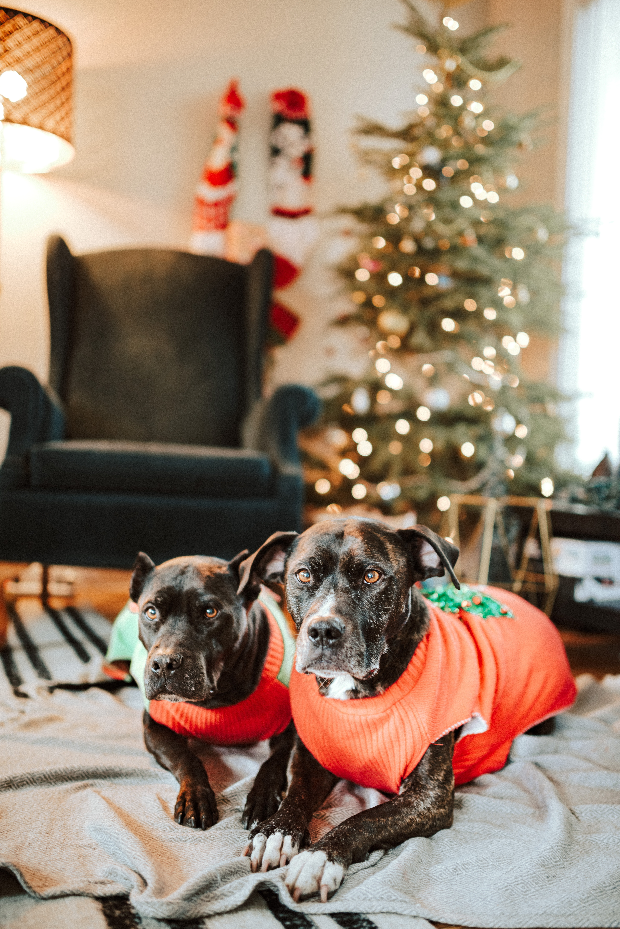

Slide 9
Photo Credits:
Slide 2: puppy photo by Bill Stephan (https://unsplash.com/photos/9LkqymZFLrE)
Slide 3: shark photo by NOAA (https://unsplash.com/photos/UwgALk2uCao)
Slide 4: boa constrictor photo by Jan Kopřiva (https://unsplash.com/photos/EPLrqHHu2WI)
Slide 5: sunset photo by Igor Kasalovic (https://unsplash.com/photos/tNDvFkxkBHo)
Slide 6: crying child photo by Nathan Dumlao (https://unsplash.com/photos/Y-H5pu2oglE)
Slide 7: snowman photo by Andreea Piratedea (https://unsplash.com/photos/lTNgUZGcPW8)
Slide 8: dogs at Christmas photo by Sandra Seitamaa (https://unsplash.com/photos/SJq4WksT8n0)

